Slide 2
Overview of Tutorial
Chapters 7 and 8 of Study Guide
Chapter 7 : Sequences and Series
Chapter 8 : Trees
Subject Matter for Tutorial
Selected end of chapter revision questions
Selected past paper questions
Also
Questions and Queries

Slide 3
Chapter 7: Sequences and Series
Sequences
Recurrence Relations
Induction
Proof by Induction : particularly important for computer scientists
Series and “Sigma Notation”

Slide 4
Chapter 7: Sequences and Series
Arithmetic Progression
For example (with constant term d=2)
U_{n+1} = U_{n} + 2
Arithmetic progressions should have an initial value term. Otherwise they are not practical.
Geometric Progression
For example (with ratio term r=3)
U_{n+1} = 3U_{n}

Slide 5
Chapter 7: Sequences and Series
Other sequences
Respective values based on previous values
Famous example: Fibonacci Sequence
0, 1, 1, 2, 3, 5, 8, 13, 21,…….

Slide 6
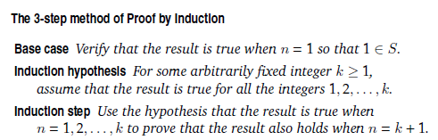
Proof By Induction
Proof by Induction
Used for proving results “for all positive integers n”

Slide 7
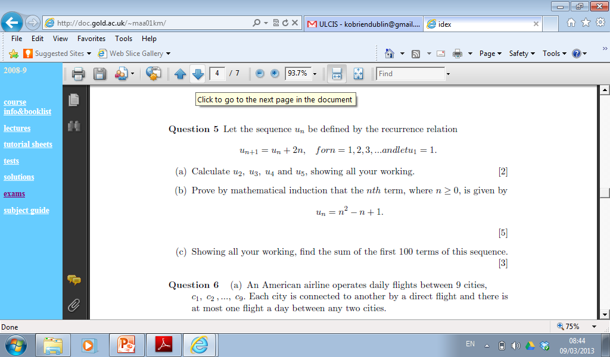
Past Paper Question (2005)

Slide 8
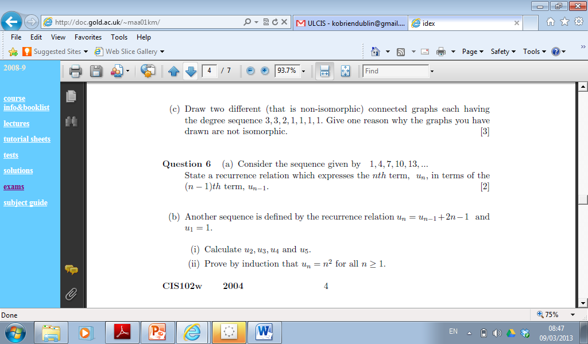
Past Paper Question (2004)

Slide 9
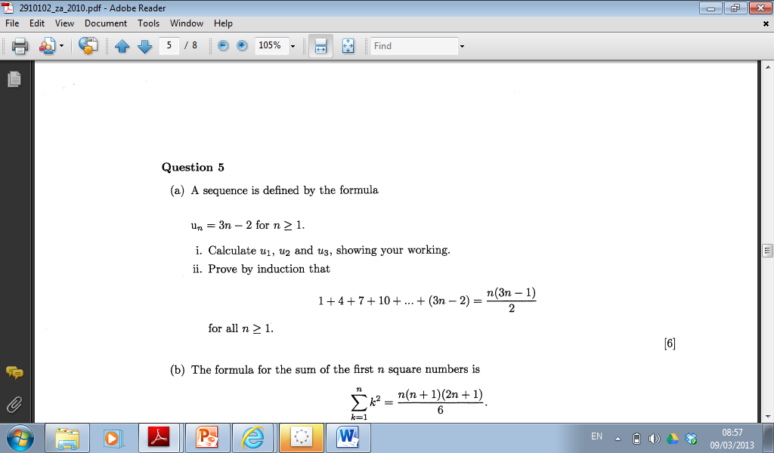
Past Paper Question (2010)

Slide 10
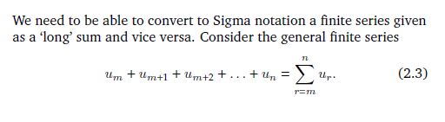
Series and Sigma Notation

Slide 11
Series and Sigma Notation
Notation is vitally important
Lower bound m
Upper bound n
Index symbol r
r is any value between m and n.
It does not need to be specified.
Pay attention to Example 2.7 – Sigma notation is not uniquely determined.
Sometime lower bound is zero. Sometimes it could be 1.

Slide 12
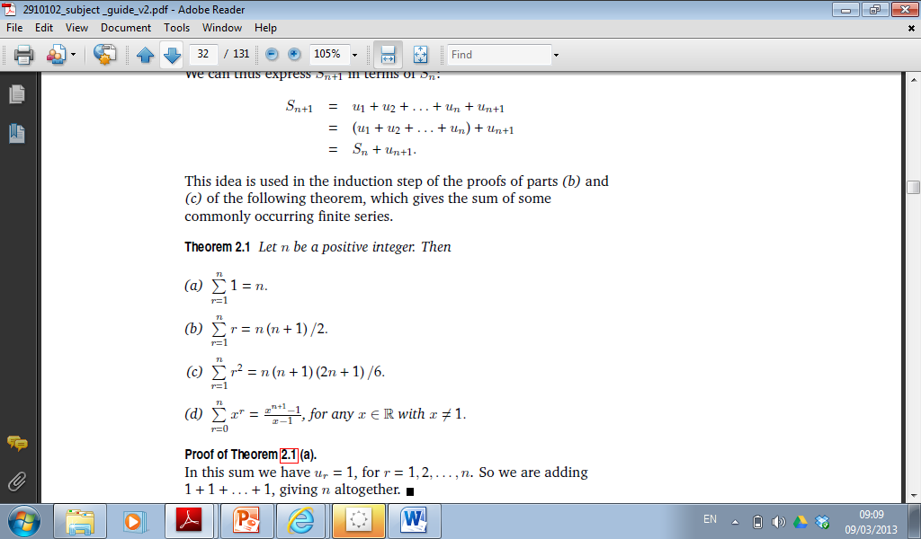
Standard Series

Slide 13
Rules for Arithmetic
1) Expressing a sum as the difference of two sums
2) Taking out common factors
3) Splitting a sum into two or more components

Slide 14
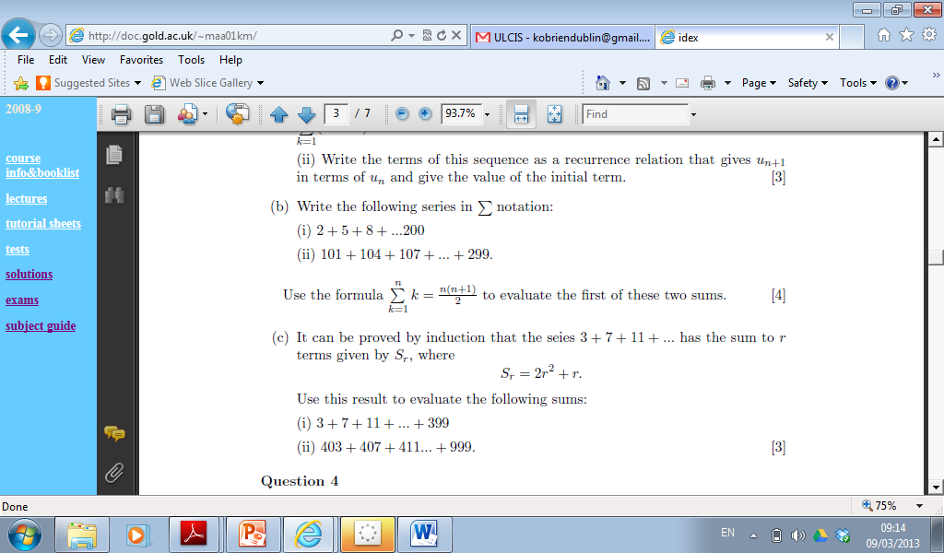
Past Paper Questions (2006)

Slide 15
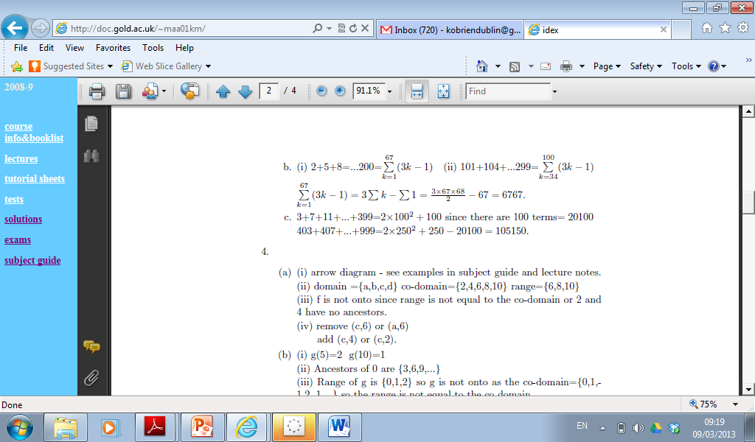
Sequence and Series
Solutions

Slide 16
Chapter 8 Trees
Trees
Definition: Connected graph with no cycles ( further to Chap. 5) .
Key Points
Two vertices of degree 1.
Spanning Tree: subgraphs has all vertices of main graph

Slide 17
Rooted Trees
Terminology
Ancestors and Descendants
Parents and Children
Levels and Heights
Internal Nodes and External Nodes
Binary Trees

Slide 18
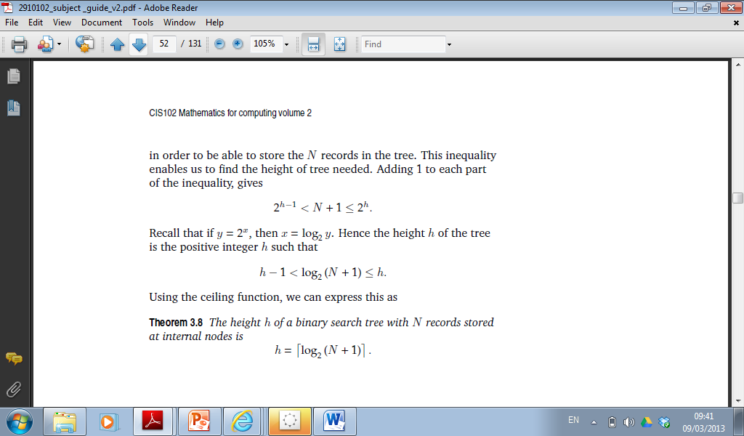
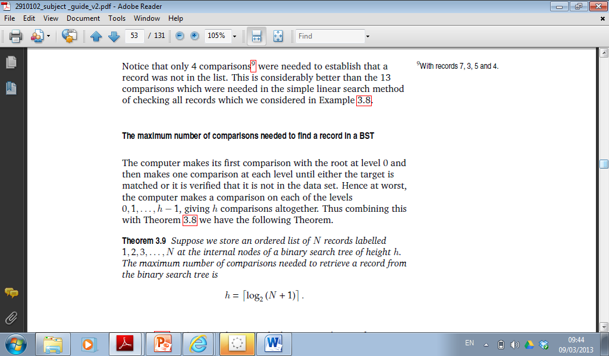
Binary Search Trees

